Slide 1

Command-Line Interface
DAI Practical Work 1

Slide 2
Difficulties
Picocli
Dictionary
Encoding

Slide 3
What to improve?
Dictionary
More options

Slide 4
Demo

Slide 5
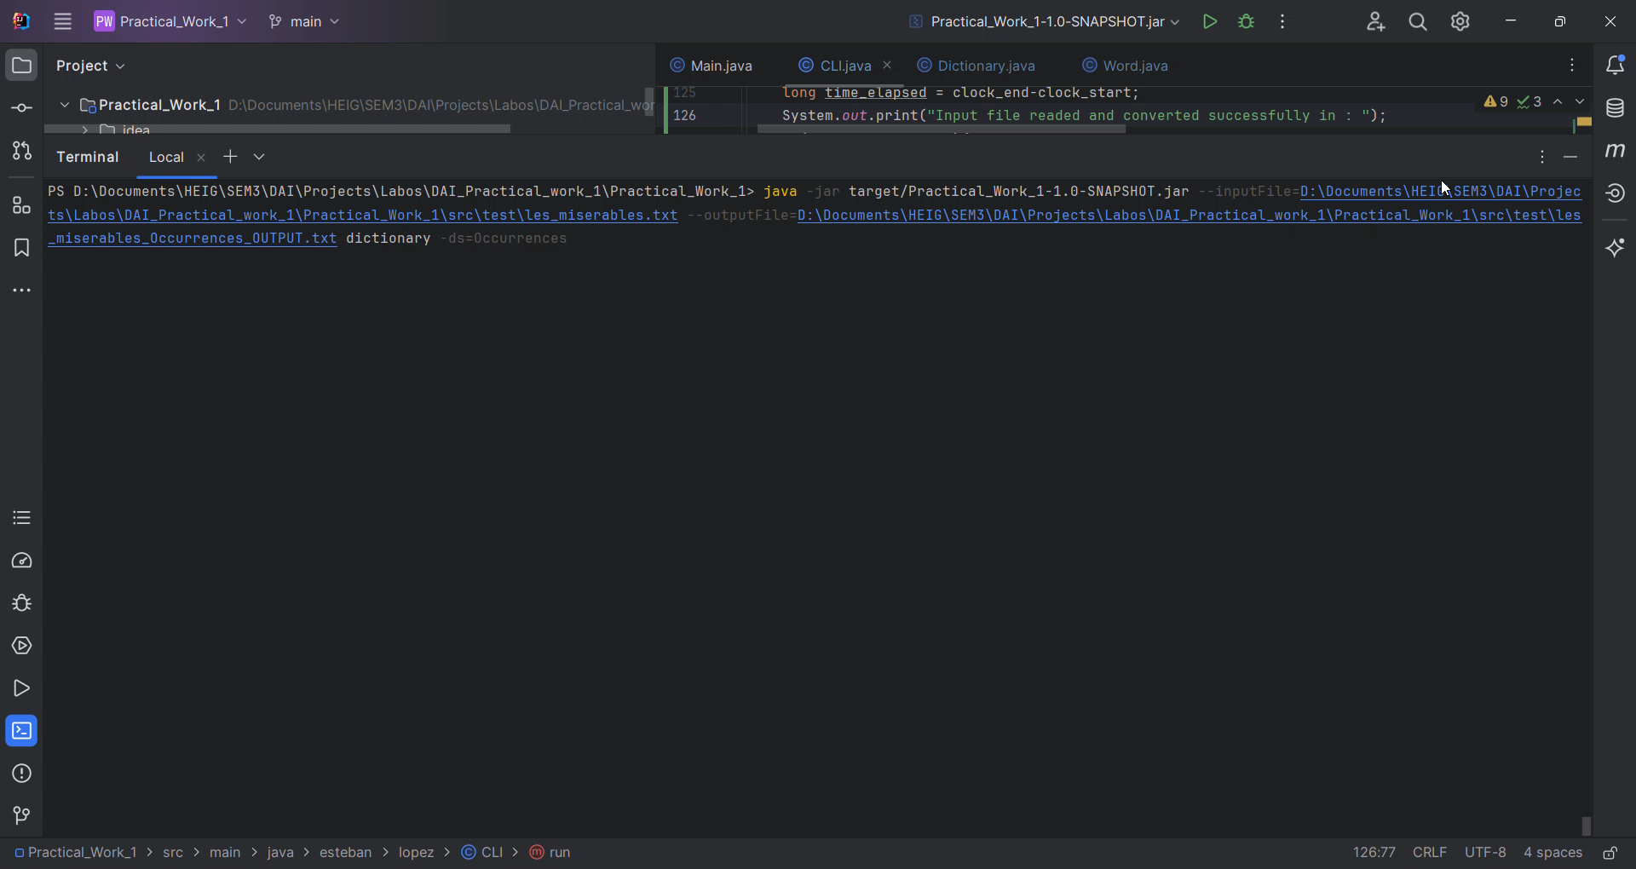
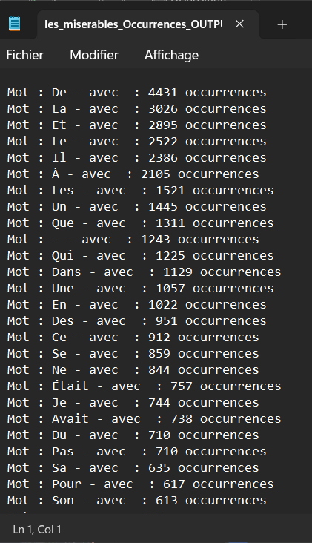

Slide 6
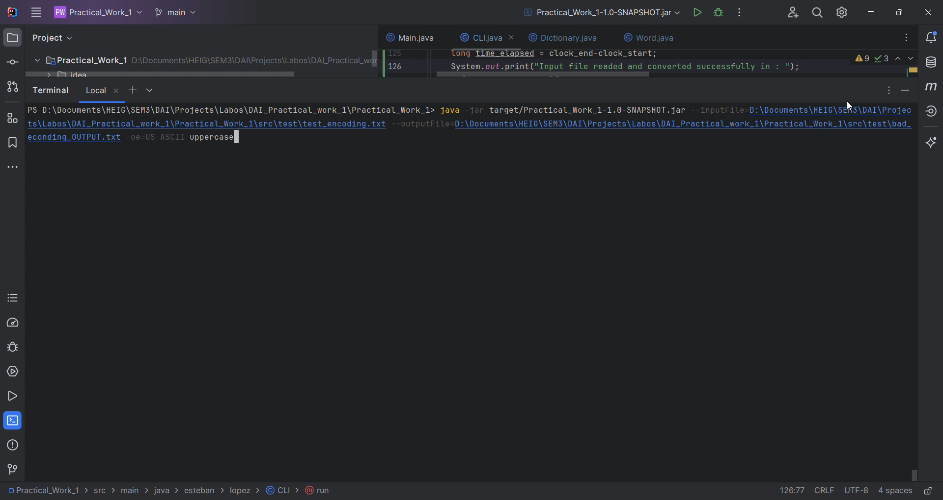
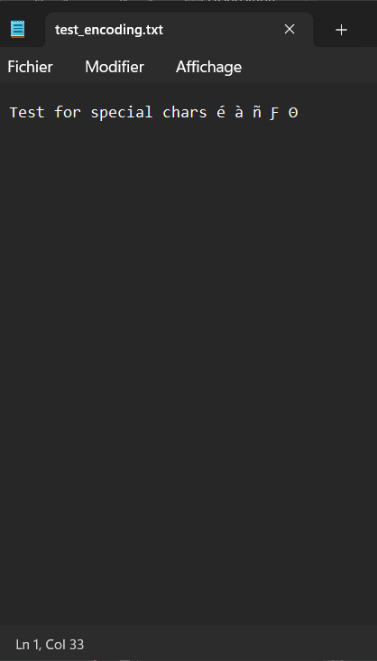
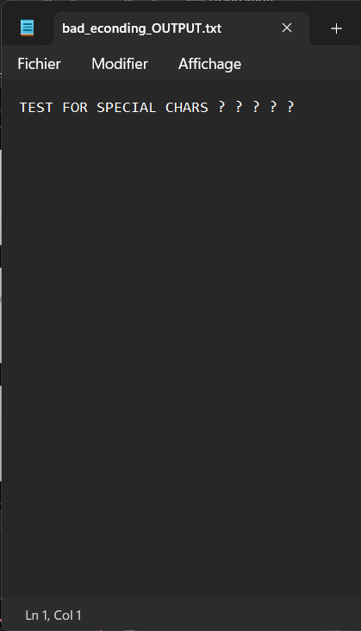

Slide 7
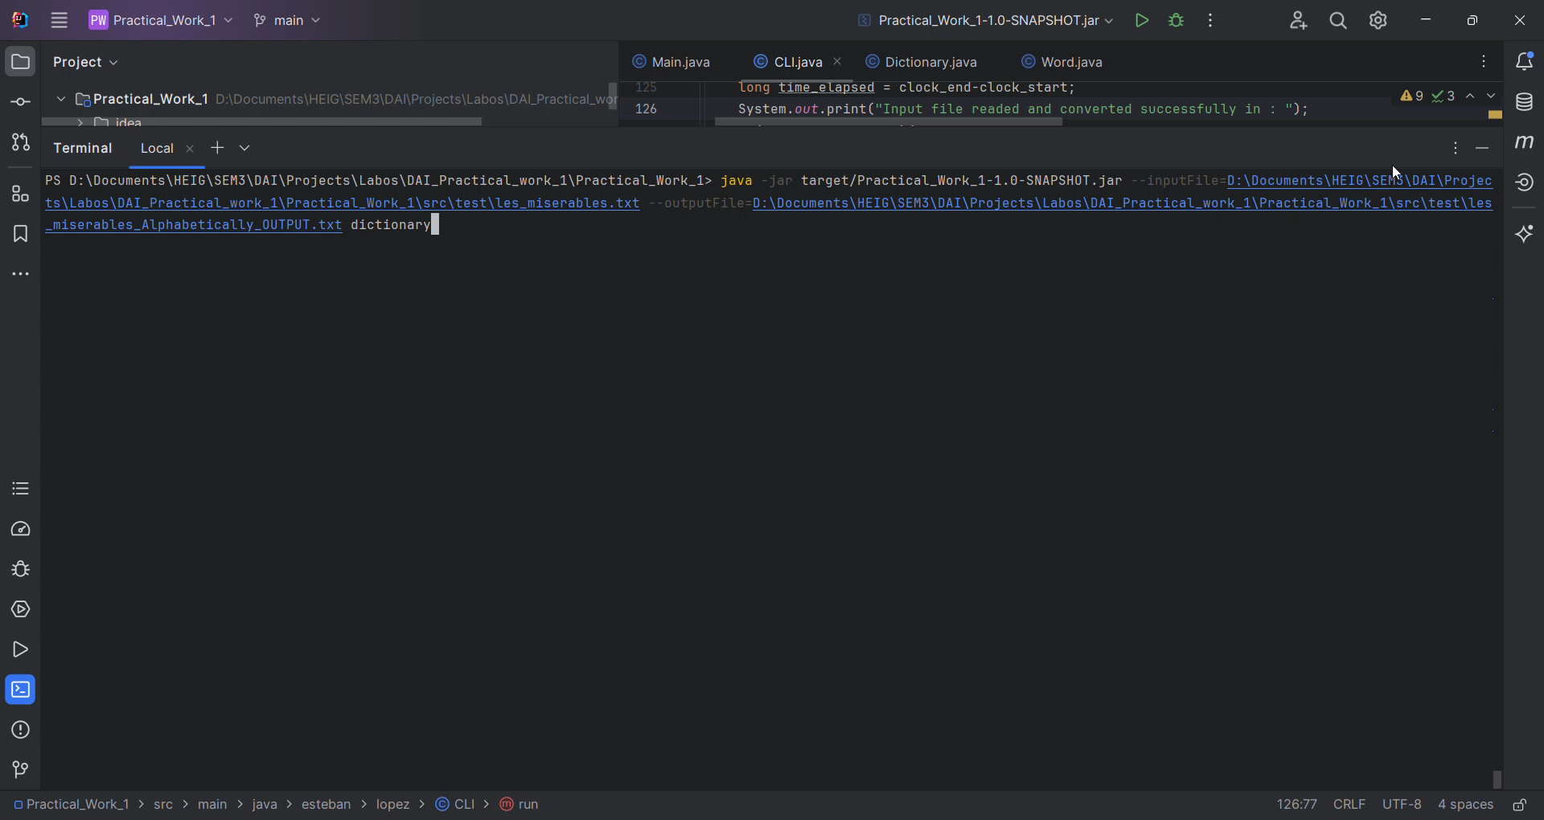
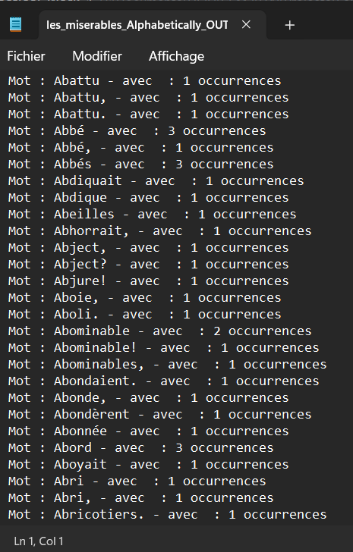

Slide 8

Thanks for your attention !
Do you have questions ?

